Slide 1






01 BITS STACK
FEATURES
HISTORY
FOLLOW
FOUNDATION
COMPARISON
TERMINOLOGIES
C LANGUAGE

Slide 2
C Language
1989 ANSI Standard for C (C89)
codified existing practices
new features: volatile, enum, signed, void, locales
From C++: const, function prototypes
1999 Standard C C99 (ISO/IEC 9899:1999)
FEATURES
FOLLOW
HISTORY
FOUNDATION
COMPARISON
TERMINOLOGIES

Slide 3
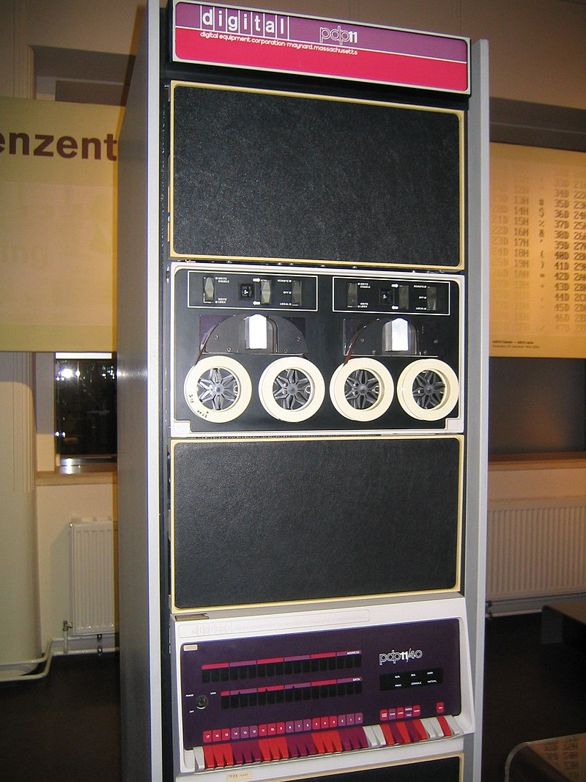
History
Invented and first implemented by Dennis Ritchie on a DEC PDP-11, Unix OS.
1969: B created, based on BCPL, to replace PDP-7 assembler as the system programming language for Unix
1973: Unix re-written in C
Brian Kerninghan and Dennis Ritchie – 6 years effort to standardise the language 83-89 (ANSI)
ISO/IEC 9899:2011, C11
ISO/IEC 9899:2018, C17/C18
C23 – Next Gen Standard
FEATURES
HISTORY
FOLLOW
FOUNDATION
COMPARISON
TERMINOLOGIES
PDP-11, Image by https://en.wikipedia.org/wiki/PDP-11

Slide 4
Features
High Level – Ada,Modula-2, Python, R, FORTAN
Middle Level – C, C++, JAVA
Low Level – Assembler
Portability
Structured Language – compartmentalize :
if (x<10)
{
printf(“Match not found!\n”);
scanf(“%d”,&x);
}
Programmer’s Language
FEATURES
HISTORY
FOLLOW
FOUNDATION
COMPARISON
TERMINOLOGIES

Slide 5
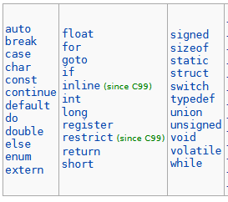
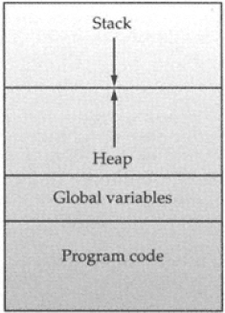
Terminologies
Compilers
Interpreters – reads one line at a time and performs specific instructions contained in that line
Keywords – dependent on compilers for exploiting operating environment
Library – most commonly needed tasks
Linking – combines the written code and the library
Memory Map of a C Program
if (x<10)
{
printf(“Match not found!\n”);
scanf(“%d”,&x);
}
C Compiler
0101011100001010
1110101010111001
0011100000111010
0101111111110000
Source Code
Binary Code
FEATURES
HISTORY
FOLLOW
FOUNDATION
COMPARISON
TERMINOLOGIES

Slide 6
Comparison – C vs C++
C++ - OOP, built upon foundation of C;
C++ superset of C
C++ compiler to compile C program
Take care about the file extension .C and .CPP
FEATURES
HISTORY
FOLLOW
COMPARISON
FOUNDATION
TERMINOLOGIES

Slide 7



THANK YOU
FEATURES
HISTORY
FOLLOW
FOUNDATION
COMPARISON
TERMINOLOGIES

